Slide 1

Supply Chain Management
7
MGT 207

Slide 2
Supply Chain
Includes everything starting with suppliers, manufacturers and/or service providers, distributors, wholesalers, retailers, and ending with final customers

Slide 3
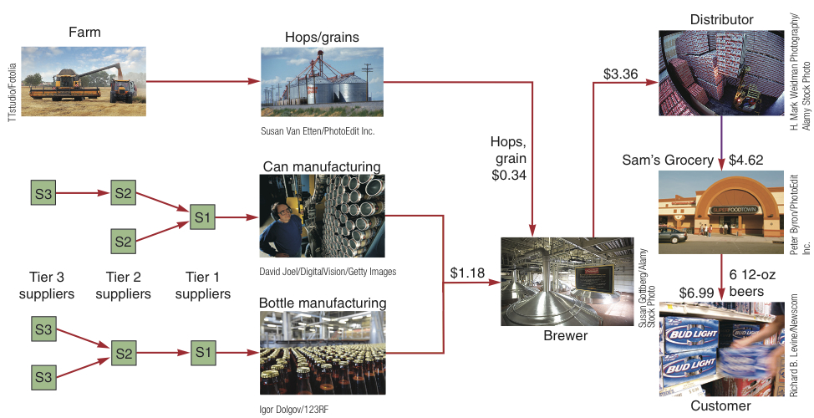
A Supply Chain for Beer
Figure 11.1

Slide 4
Supply Chain Objective
The coordination of all supply chain activities, starting with raw materials and ending with the customer

Slide 5
Supply Chain Costs
TABLE 11.1
Supply Chain Costs as a Percentage of Sales
INDUSTRY |  | % PURCHASED
Automobiles |  | 67
Beverages |  | 52
Chemical |  | 62
Food |  | 60
Lumber |  | 61
Metals |  | 65
Paper |  | 55
Petroleum |  | 79
Restaurants |  | 35
Transportation |  | 62

Slide 6
Supply Chain at Emerson Electric
Product Design Stage (Engineers)
SC Strategy Design
Production
SCM Department
Product Concept (Marketing)
Product design changes
Material substitutions
Supplier selections
Working SC
Material procurement strategies

Slide 7
SCM Strategies
TABLE 11.2 | How Corporate Strategy Impacts Supply Chain Decisions
 |  | LOW-COST STRATEGY | RESPONSE STRATEGY | DIFFERENTIATION STRATEGY
Primary supplier selection criteria |  | Cost | Capacity Speed Flexibility | Product development skills Willing to share information Jointly and rapidly develop products
Supply chain inventory |  | Minimize inventory to hold down costs | Use buffer stocks to ensure speedy supply | Minimize inventory to avoid product obsolescence
Distribution network |  | Inexpensive transportation Sell through discount distributors/ retailers | Fast transportation Provide premium customer service | Gather and communicate market research data Knowledgeable sales staff
Product design characteristics |  | Maximize performance Minimize cost | Low setup time Rapid production ramp-up | Modular design to aid product differentiation

Slide 8
Popular Supply Chain Setups
Many suppliers
Few suppliers
Vertical integration
Keiretsu networks

Slide 9
Many Suppliers
Commonly used for commodity products
Purchasing is typically based on price
Suppliers compete with one another
Supplier is responsible for technology, expertise, forecasting, cost, quality, and delivery

Slide 10
Few Suppliers
Buyer forms long term relationships with fewer suppliers
Create value through economies of scale and learning curve improvements
Suppliers more willing to participate in JIT programs and contribute design and technological expertise
Cost of changing suppliers is huge
Trade secrets and other alliances may be at risk

Slide 11
Vertical Integration
Vertical Integration Examples of Vertical Integration
Raw material (suppliers) |  |  | Tree Harvesting
Backward integration |  | Chipmakers | Pulpmaking
Current transformation | Pepsi | Apple | International Paper
Forward integration | Bottling | Retail stores | End-User Paper Conversion
Finished goods (customers)
Figure 11.2

Slide 12
Vertical Integration
Developing the ability to produce goods or services previously purchased
Integration may be forward, towards the customer, or backward, towards suppliers
Can improve cost, quality, delivery, and inventory but requires capital, managerial skills, and demand
Risky in industries with rapid technological change

Slide 13
Keiretsu Networks
A middle ground between few suppliers and vertical integration
Supplier becomes part of the company coalition
Often provide financial support for suppliers through ownership or loans
Members expect long-term relationships and provide technical expertise and stable deliveries
May extend through several levels of the supply chain

Slide 14
Supplier Recruitment

Slide 15
Supplier Relationship Process (1 of 5)
Purchasing: the activity that decides which suppliers to use and negotiates contracts.
Involves five nested processes
  Sourcing
  Design collaboration
  Negotiation
  Buying
  Vendor-managed inventories

Slide 16
Supplier Relationship Process (2 of 5)
Supplier selection
  Material costs
    Annual material costs = pD
  Freight costs
  Inventory costs
    Cycle inventory =
    Pipeline inventory =
    Annual inventory costs =
  Administrative costs
  Total Annual Cost =

Slide 17
Example 1 (1 of 5)
Compton Electronics manufactures laptops for major computer manufacturers. A key element of the laptop is the keyboard. Compton has identified three potential suppliers for the keyboard, each located in a different part of the world. Important cost considerations are the price per keyboard, freight costs, inventory costs, and contract administrative costs. The annual requirements for the keyboard are 300,000 units. Assume Compton has 250 business days a year. Managers have acquired the following data for each supplier.
Which supplier provides the lowest annual total cost to Compton?

Slide 18
Example 1 (2 of 5)
Annual Freight Costs
Supplier | Shipping Quantity (units/shipment) 10,000 | Shipping Quantity (units/shipment) 20,000 | Shipping Quantity (units/shipment) 30,000
Belfast | $380,000 | $260,000 | $237,000
Hong Kong | $615,000 | $547,000 | $470,000
Shreveport | $285,000 | $240,000 | $200,000
Keyboard Costs and Shipping Lead Times
Supplier | Price/Unit | Annual Inventory Carrying Cost/Unit | Shipping Lead Time (days) | Administrative Costs
Belfast | $100 | $20.00 | 15 | $180,000
Hong Kong | $96 | $19.20 | 25 | $300,000
Shreveport | $99 | $19.80 | 5 | $150,000

Slide 19
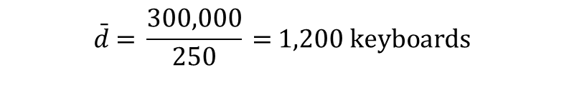
Example 1 (3 of 5)
The average requirements per day are:
$$\bar{d}\text{ = }\frac{\text{300,000}}{\text{250}}\text{ = }1,200 keyboards$$
  Total Annual Cost =

Slide 20
Example 1 (4 of 5)
BELFAST: Q = 10,000 units.
  Material costs = pD =
  = $30,000,000
  Freight costs = $380,000
  Inventory costs = (cycle inventory + pipeline inventory) H
  = $460,000
  Administrative costs = $180,000
  Total Annual Cost = $30,000,000 + $380,000 + $460,000 + $180,000 = $31,020,000

Slide 21
Example 1 (5 of 5)
The total costs for all three shipping quantity options are similarly calculated and are contained in the following table.
Supplier | Shipping Quantity 10,000 | Shipping Quantity 20,000 | Shipping Quantity 30,000
Belfast | $31,020,000 | $31,000,000 | $31,077,000
Hong Kong | $30,387,000 | $30,415,000 | $30,434,000
Shreveport | $30,352,800 | $30,406,800 | $30,465,800

Slide 22
A Mini Case Study
BMW Supply Chain

Slide 23
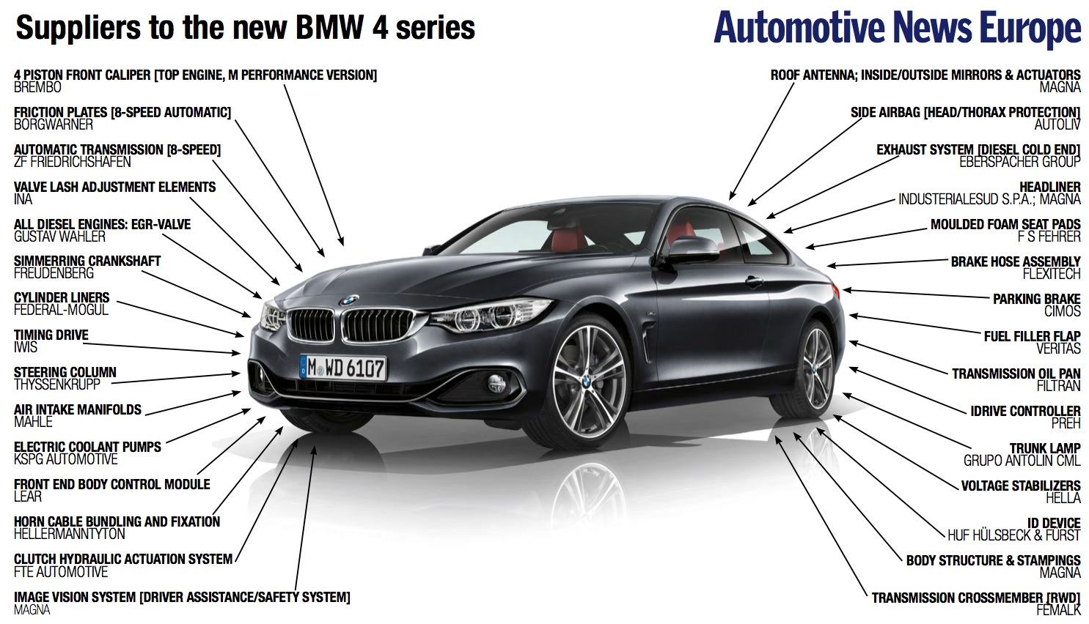
01 | Motivation
Source: Automotive News Europe

Slide 24
Procurement Protocol
02 | Model & Hypotheses
Automotive procurement protocol
  Commitment + Top-up stage (±10%)
    Vs. Traditional ordering in each decision period happens in a single shot
  Both pricing & supplier are decided via auction by buyer
    Vs. Traditional prices set strategically by supplier
  Cost + Demand uncertainty
    Vs. Traditional only demand uncertainty
  Asymmetric information: Upstream party has
  private information about cost
    Vs. Traditional: downstream party holds private information about demand
Notes:
Interest of time, don’t go into details. IN GENERAL, how we differ from literature.
Procurement protocol is different from how automotive industry actually works.

Slide 25
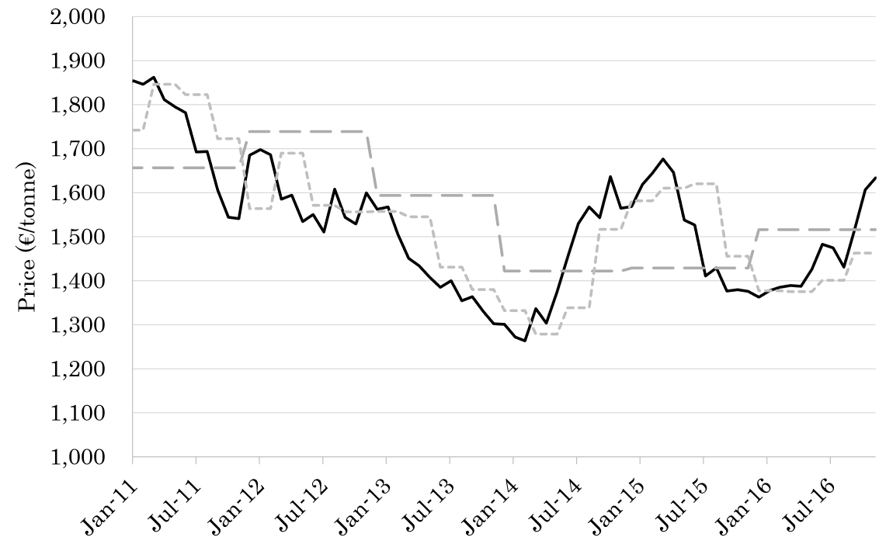
Contracts at BMW
03 | Model & Hypotheses
Fixed-price (Price Adjustment)
  BMW pays R&D/tooling cost +
  fixed raw material cost
  Supplier is absorbing all raw material
  cost volatility
Cost-Plus (Material-Plus-Surcharge)
  BMW reimburses R&D/tooling cost +
  floating raw material cost
  BMW is absorbing all raw material
  cost volatility
LME Aluminum
Fixed-Price
Cost-Plus

Slide 26
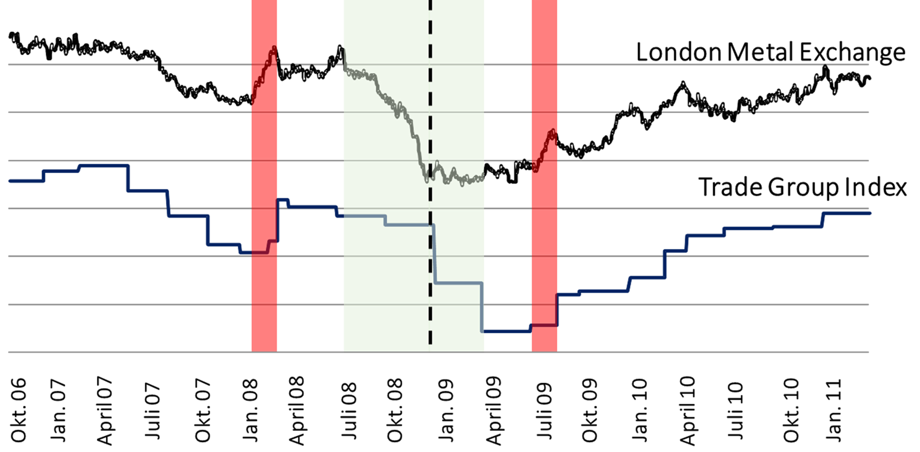
Price Distortion
01 | Motivation
Price increases on LME,
Trade group index follows
Price decreases on LME,
Trade group index slow to respond
Source: BMW Internal Documents

Slide 27
Supply chain risk

Slide 28
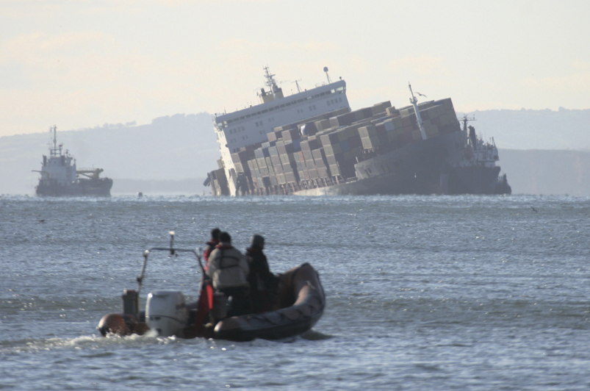
Supply Chain Risk
More reliance on supply chains means more risk
Fewer suppliers increase dependence
Compounded by globalization and logistical complexity
Vendor reliability and
quality risks
Political and
currency risks

Slide 29
Supply Chain Disruptions
  Environmental Disruptions
  Supplier-Induced Volume Changes
  Product Mix Changes
  Late Deliveries

Slide 30
Hedging Operational Disruption

Slide 31
Supplier Diversification Model
Hedge risk by having n suppliers for the same item
For a given supply cycle, the probability of n suppliers being disrupted is
S = the probability of a “super-event” that would disrupt all suppliers simultaneously
U = the probability of a “unique-event” that would disrupt only one supplier
L = the financial loss incurred in a supply cycle if all suppliers were disrupted
C = the marginal cost of managing a supplier

Slide 32
How Many Suppliers?
Portfolio of suppliers to balance costs and risks
Evaluate one, two, or three suppliers using a decision tree
S = 0.5%, U = 4%, C = $10,000, L = $10,000,000
P(1) = 0.005 + (1 – 0.005)0.04 = 0.005 + 0.0398
= 0.044800, or 4.4800%
P(2) = 0.005 + (1 – 0.005)0.04² = 0.005 + 0.001592
= 0.006592, or 0.6592%
P(3) = 0.005 + (1 – 0.005)0.04³ = 0.005 + 0.000064
= 0.005064, or 0.5064%

Slide 33


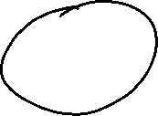


How Many Suppliers?
One supplier
$458,000
1 – P(1) = .955200
No failure
1C = (1)$10,000 = $10,000
P(1) = .044800
Failure
L + 1C = $10,000,000 + (1)$10,000
= $10,010,000
Two suppliers
$85,920
1 – P(2) = .993408
≤ 1 Fail
2C = (2)$10,000 = $20,000
P(2) = .006592
Both fail
L + 2C = $10,000,000 + (2)$10,000
= $10,020,000
1 – P(3) = .994936
≤ 2 Fail
3C = (3)$10,000 = $30,000
P(3) = .005064
All three fail
L + 3C = $10,000,000 + (3)$10,000
= $10,030,000
Three suppliers
$80,640
Figure S11.1

Slide 34
Supply Chain Risk Management (continued)
Managing the risk of SC disruption by using multiple suppliers: operational hedging
Hedging threats to financial flows in the supply chain: financial hedging

Slide 35
Hedging financial Disruption

Slide 36
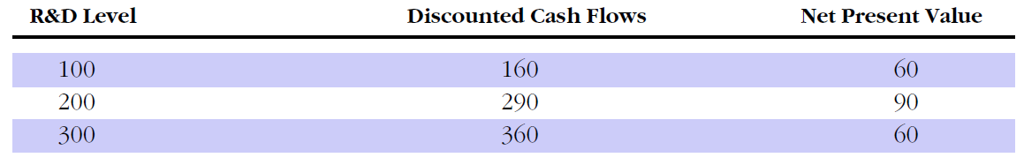
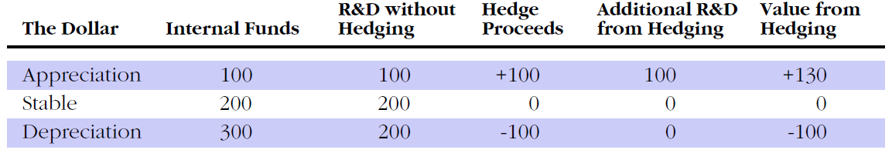
AN Example
Example: Omega Drug, a hypothetical multinational pharmaceutical company
Supply Chain Risk Management

Slide 37
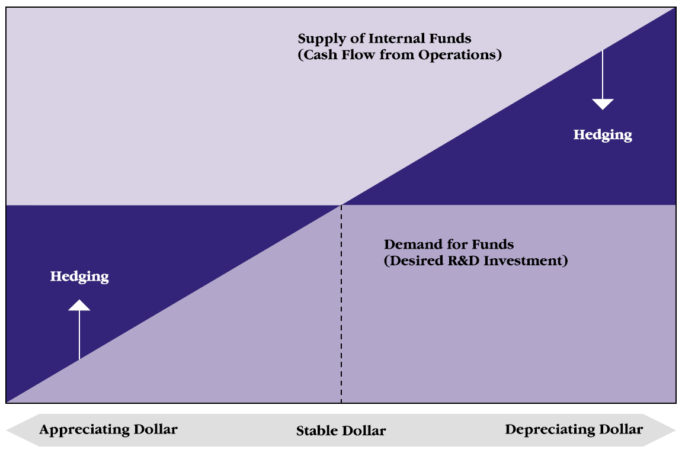
why hedge? (continued)
Risk management lets companies transfer funds from situation in which they have an excess supply to situations in which they have shortage
  … borrow from themselves
Supply Chain Risk Management

Slide 38
Supply Chain Dynamics
Bullwhip Effect

Slide 39
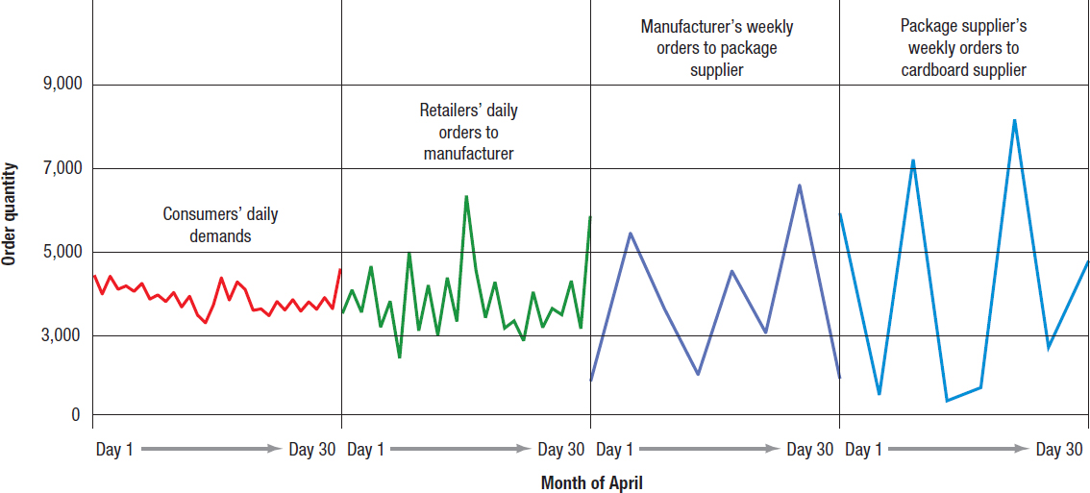
Supply Chain Dynamics (2 of 2)
The Bullwhip Effect
Figure 14.2 Supply Chain Dynamics for Facial Tissue

Slide 40
Definition and Characteristics
Definition: A phenomenon where small fluctuations in demand at the retail level are amplified as they move up the supply chain.
Key Characteristic: Each stage of the supply chain orders more goods than necessary to meet demand, leading to excess inventory and inefficiencies.

Slide 41
Example
Week | Retailer Demand | Retailer Order | Distributor Order | Wholesaler Order | Manufacturer Order
1 | 110 | 120 | 140 | 180 | 220
2 | 110 | 110 | - | - | -
In this simplified example, a 10% increase in customer demand at the retailer level leads to a 20% increase in the retailer's order, a 40% increase in the distributor's order, and so on. By the time it reaches the manufacturer, the order has more than doubled, even though the actual consumer demand has stabilized. This demonstrates how the bullwhip effect can quickly distort demand signals.

Slide 42

Consequences
Excess inventory
Increased costs
Stockouts (when demand is underestimated)
Reduced customer service level
Wasted resources

Slide 43
Managing the Bullwhip Effect
TABLE S11.1 | The Bullwhip Effect
CAUSE |  | REMEDY
Demand forecast errors (cumulative uncertainty in the supply chain) |  | Share demand information throughout the supply chain
Order batching (large, infrequent orders leading suppliers to order even larger amounts) |  | Channel coordination: Determine lot sizes as though the full supply chain was one company
Price fluctuations (buying in advance of demand to take advantage of low prices, discounts, or sales) |  | Price stabilization (everyday low prices)
Shortage gaming (hoarding supplies for fear of a supply shortage) |  | Allocate orders based on past demand

Slide 44
The Bullwhip Effect Measure
If measure is:
> 1 ➔ Variance amplification is present
= 1 ➔ No amplification is present
< 1 ➔ Smoothing or dampening is occurring

Slide 45
Calculating the Bullwhip Effect
Transform sheet steel to tabletops
Each firm in the supply chain has one supplier and one customer
FIRM | VARIANCE OF DEMAND | VARIANCE OF ORDERS | BULLWHIP MEASURE
Furniture Mart, Inc. | 100 | 110 | 110/100 = 1.10
Furniture Distributors, Inc. | 110 | 180 | 180/110 = 1.64
Furniture Makers of America | 180 | 300 | 300/180 = 1.67
Chieh Lee Metals, Inc. | 300 | 750 | 750/300 = 2.50
Metal Suppliers Ltd. | 750 | 2000 | 2000/750 = 2.67

Slide 46
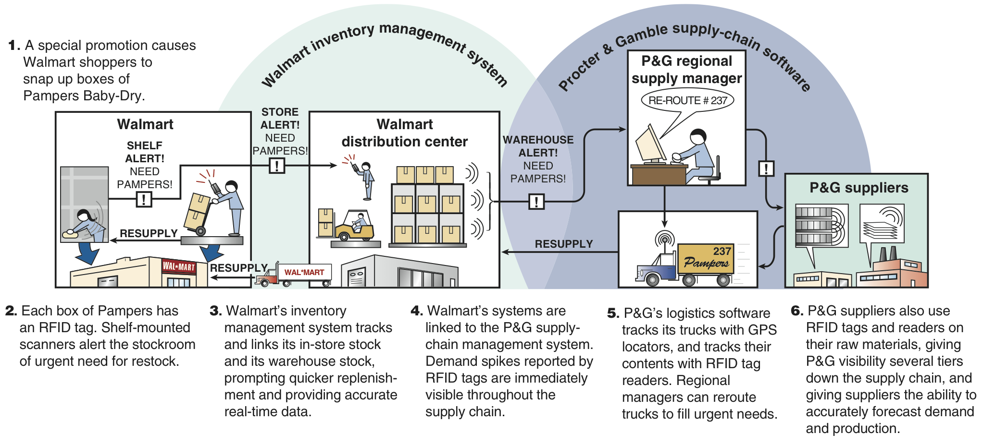
RFID Helps Control Bullwhip

Slide 47
Summary
The bullwhip effect can have serious consequences for businesses, including financial losses, operational inefficiencies, and strained relationships with partners. However, by implementing strategies to improve communication, collaboration, and demand forecasting, companies can minimize the impact of the bullwhip effect and create more stable and profitable supply chains.

Slide 48
Supply Chain COntracting
Double Marginalization

Slide 49
One-to-One Supply Chain Example
Demand is 60 with probability of ½ and 120 with probability ½
Retail price = p
Wholesale price = w
Production cost = c
Suppose p=32,c=15,w=18

Slide 50
Wholesale Contract
Supplier charges the retailer a unit price of w
Supplier pays a unit of c produce the product

Slide 51
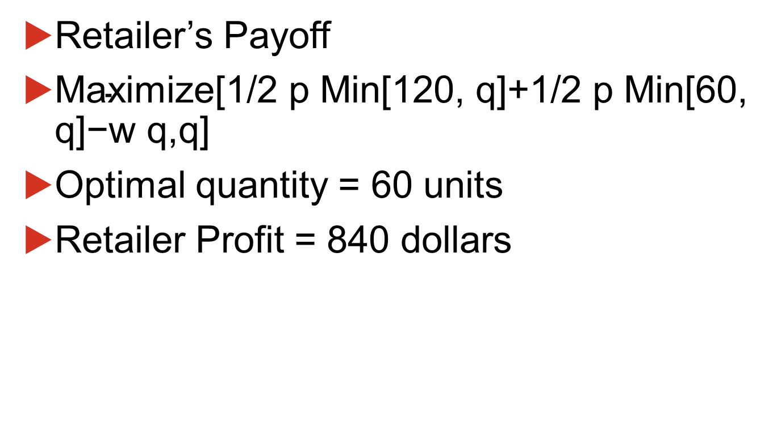
Retailer’s Profit with Wholesale Contract
Retailer’s Payoff
$\text{Maximize}\text{[1/2 }\text{p} \text{Min}\text{[120, }\text{q}\text{]+1/2 }\text{p} \text{Min}\text{[60, }\text{q}\text{]−}\text{w} \text{q}\text{,}\text{q}\text{]}$
Optimal quantity = 60 units
Retailer Profit = 840 dollars

Slide 52
Supplier’s Profit with Wholesale Contract
Supplier’s Payoff
q(w-c)=60(18-15)=180
Optimal quantity = 60 units
Supplier Profit = 180 dollars
Total supply chain profit: 840+180=1020

Slide 53
Vertical Integration
Maximize[1/2 p Min[120, q]+1/2 p Min[60, q]-c q,q]
Optimal quantity = 120 units
Total supply chain profit = 1080 dollars>1020 dollars in the decentralized case

Slide 54
Two-Part Tariff Contract
Suppose the supplier agrees to sell at cost, i.e., w=15 plus a fixed fee of 180 dollars
180=fixed tariff; 15=floating tariff
Optimal quantity = 120 units (why?)
Supplier’s payoff=180 (why?)
Retailer’s profit = 1080-180=900 dollars > 840 dollars, which what the retailer made in the decentralized case

Slide 55
Contracts Similar to Two-Part Tariff
Buy-back
Revenue sharing
Price-quantity menus

